Slide 1


Slide 2

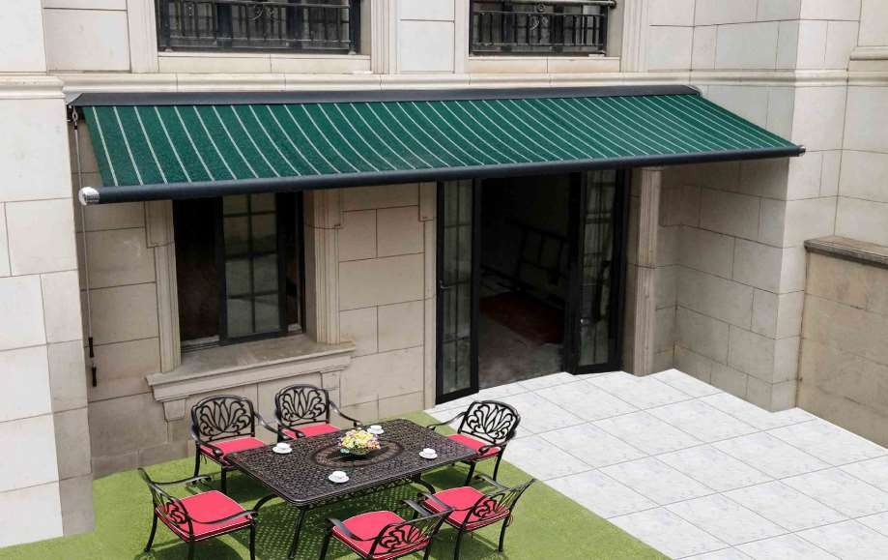
www.alunotec.com
Electric Full cassette Aluminum
RETRACTABLE AWNING

Slide 3
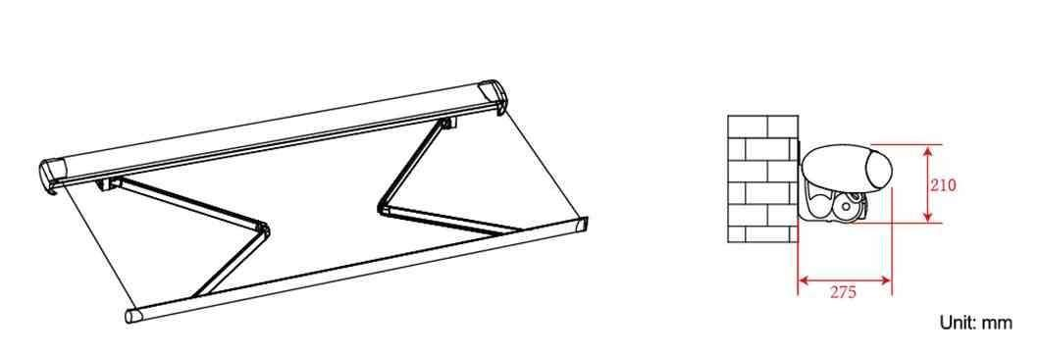
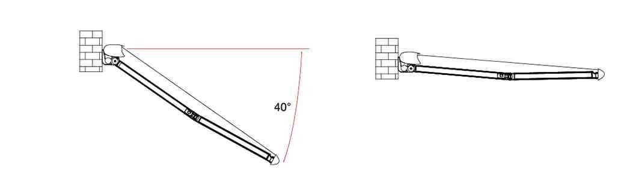
Product Size
Installation Ways

Slide 4
Product Detail
Diamond arm improves strength and intensity, using chain instead of steel wire for the spring pull to avoid rupture.
Customizable size range
Min size | Max size
200cm*150cm | 600cm*350cm
Chrome plated is the metal coating on the surface to change nature of the materials, improve its hardness, prevent wearing, resist heat to keep the surface elegant.
Close-in style adjuster for up and down, it change the traditional adjusting way of exposing the screws, makes adjusting more ﬂexible and stable.

Slide 5
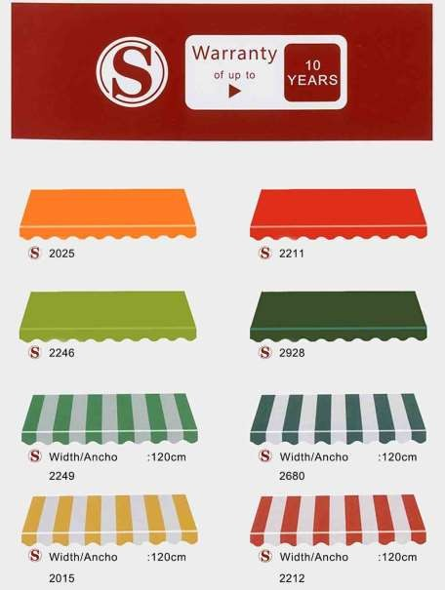
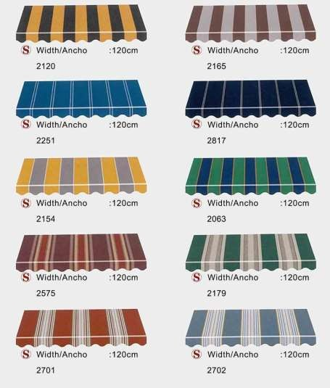
Fabric Partial Color

Slide 6

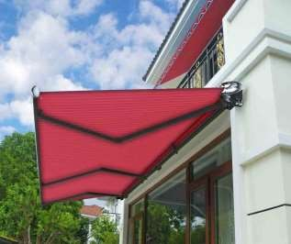
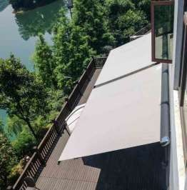
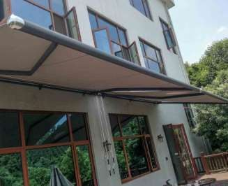


Project Cases

Slide 7


