Slide 1

Swim Pool Coverage System
Sliding Deck Pool Cover Series
Prefessional R&D, Production, Installation of Pool
Cover System

Slide 2

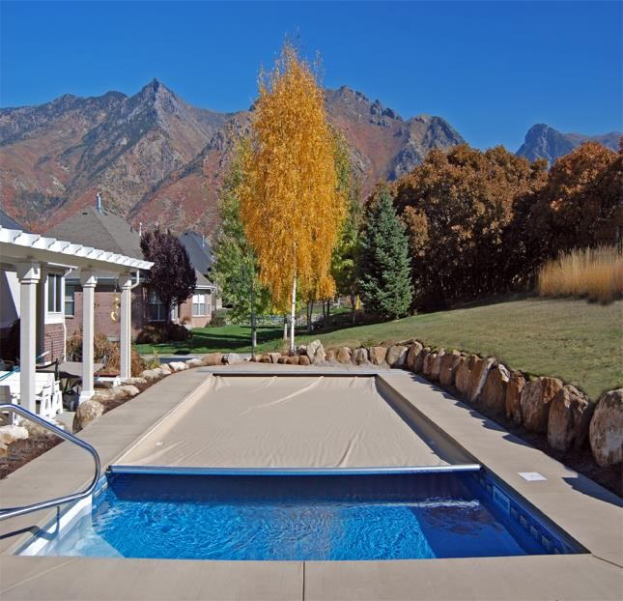
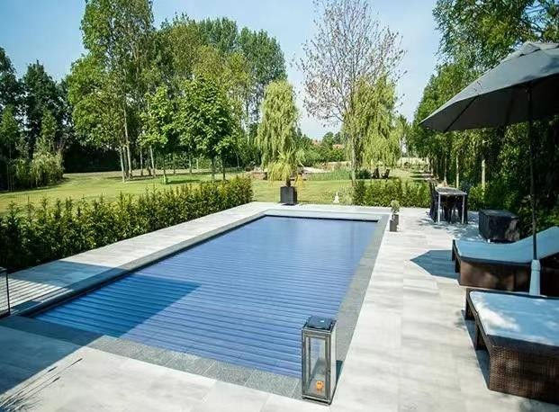
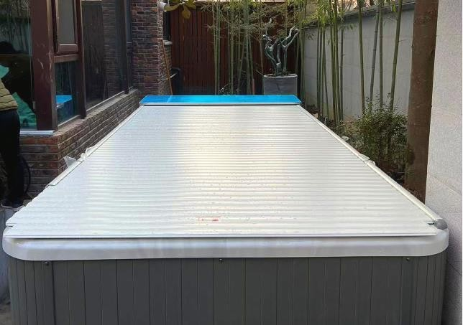
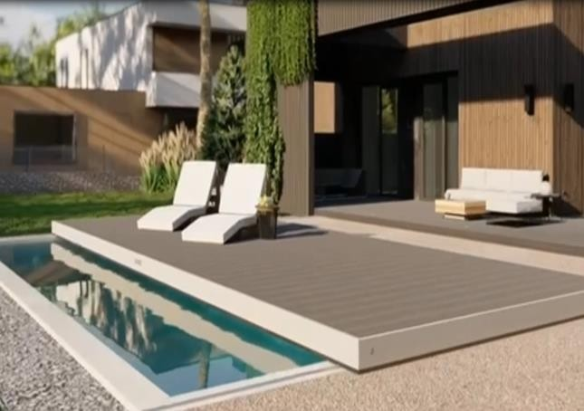
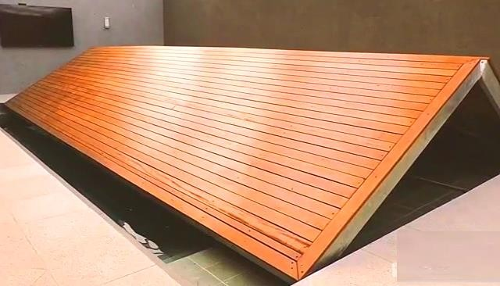
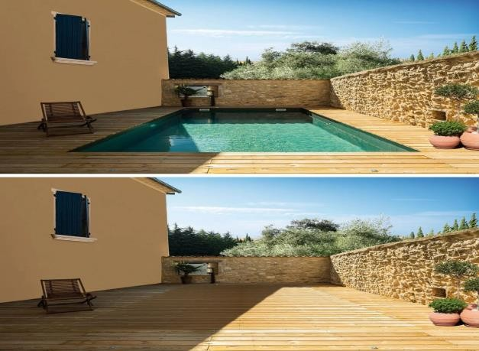




Slide 3

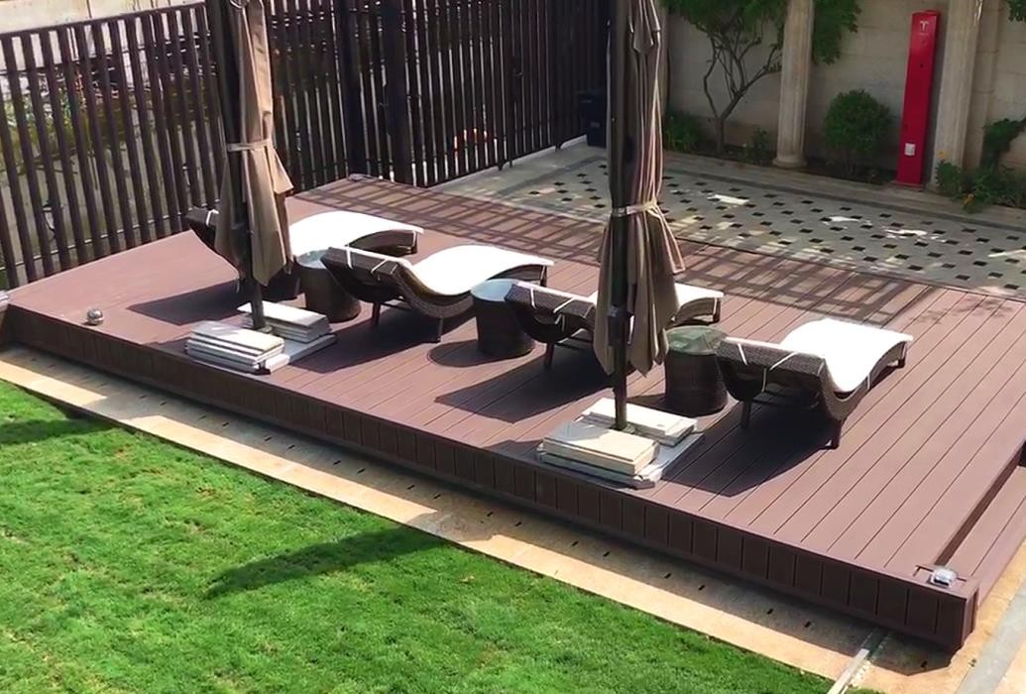
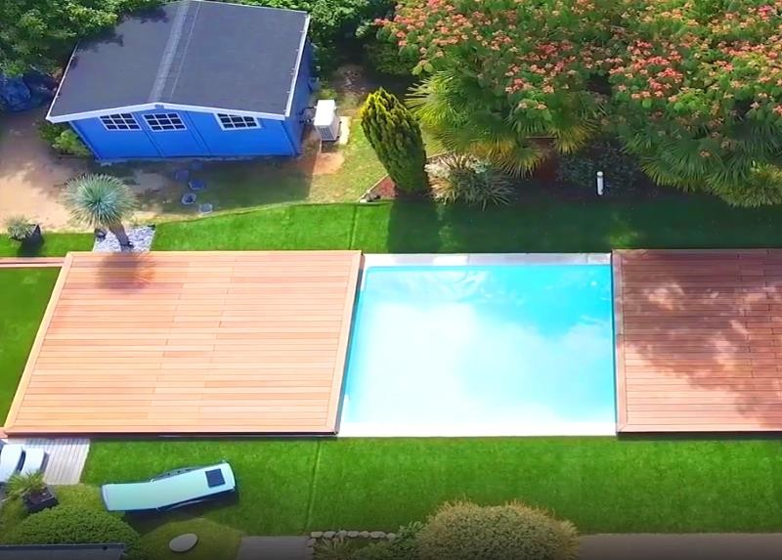
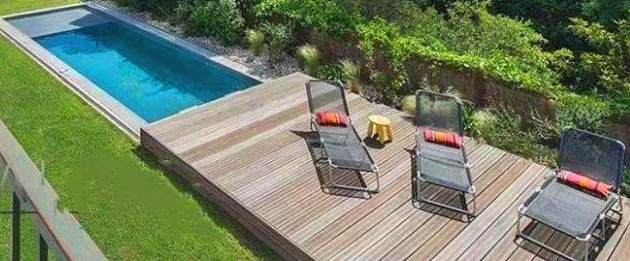
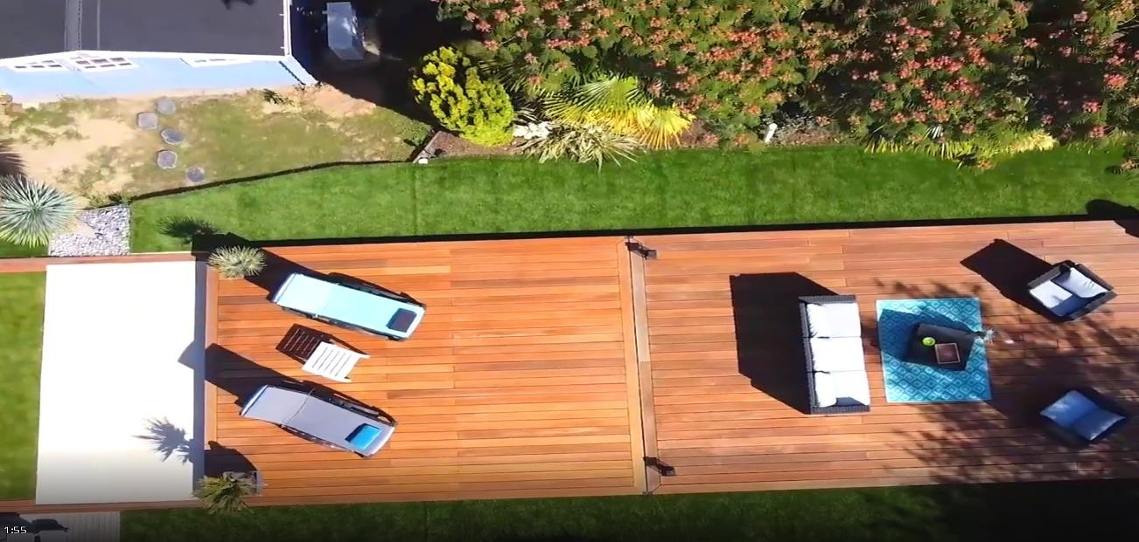
Cross
Split
Longitudinal

Slide 4
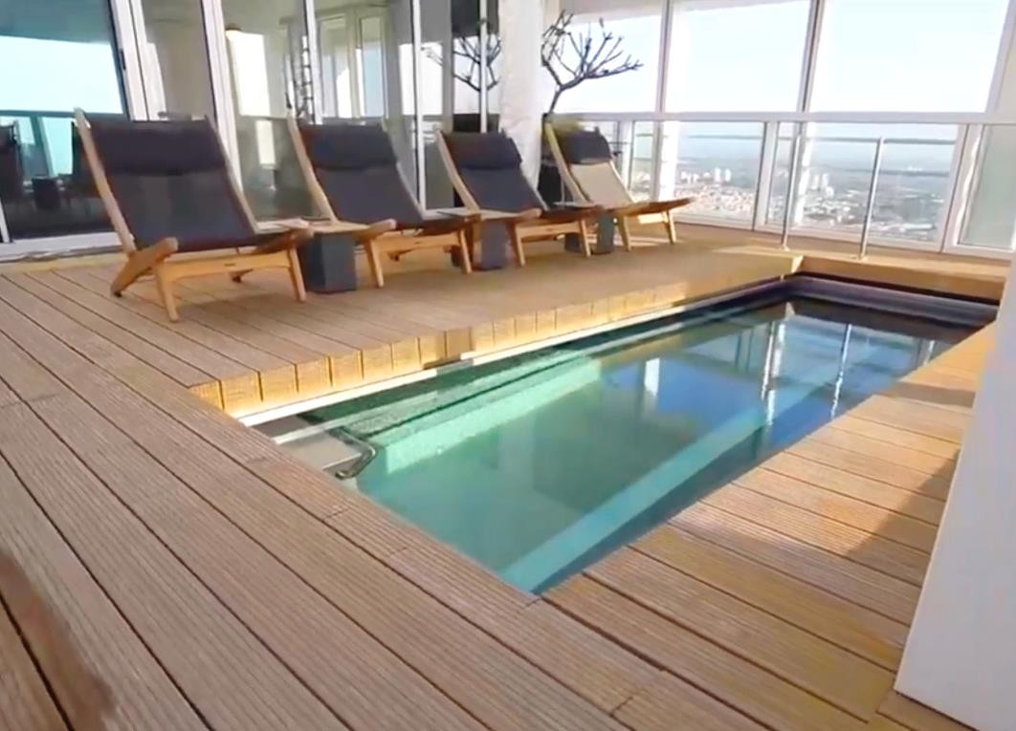
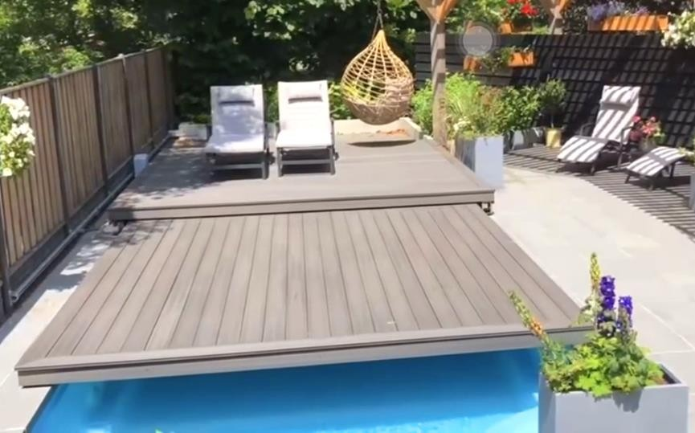
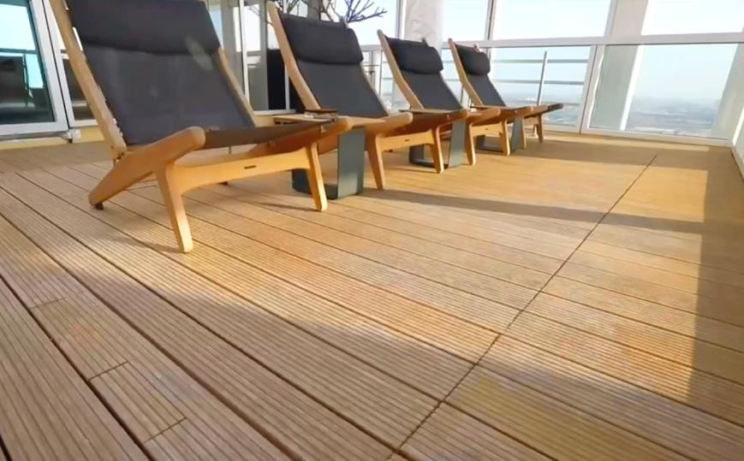
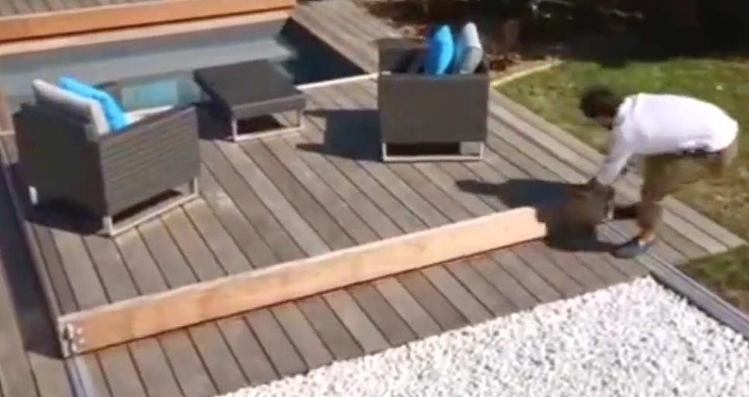
Hidden
Double Layer
Manual

Slide 5
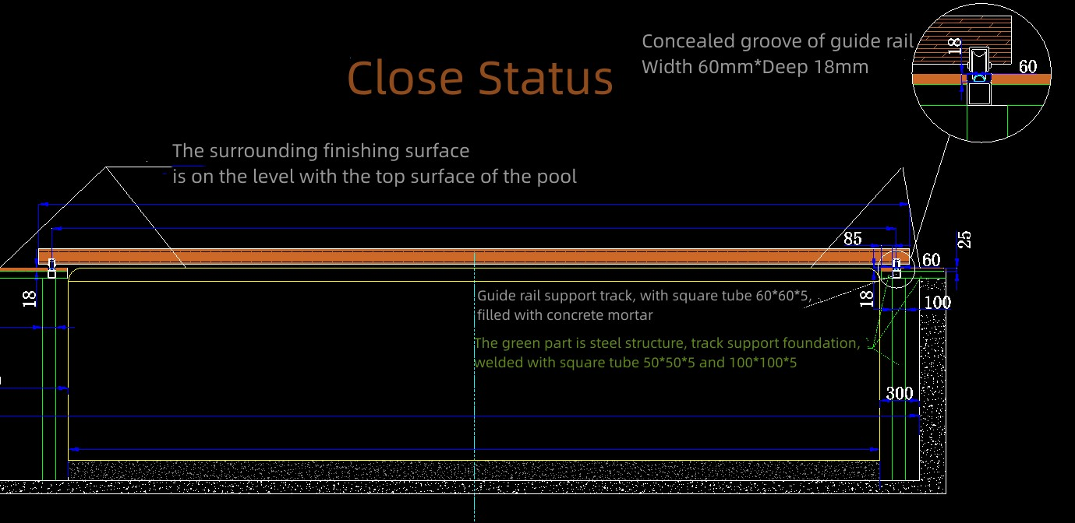
Contruction Diagram（1）

Slide 6
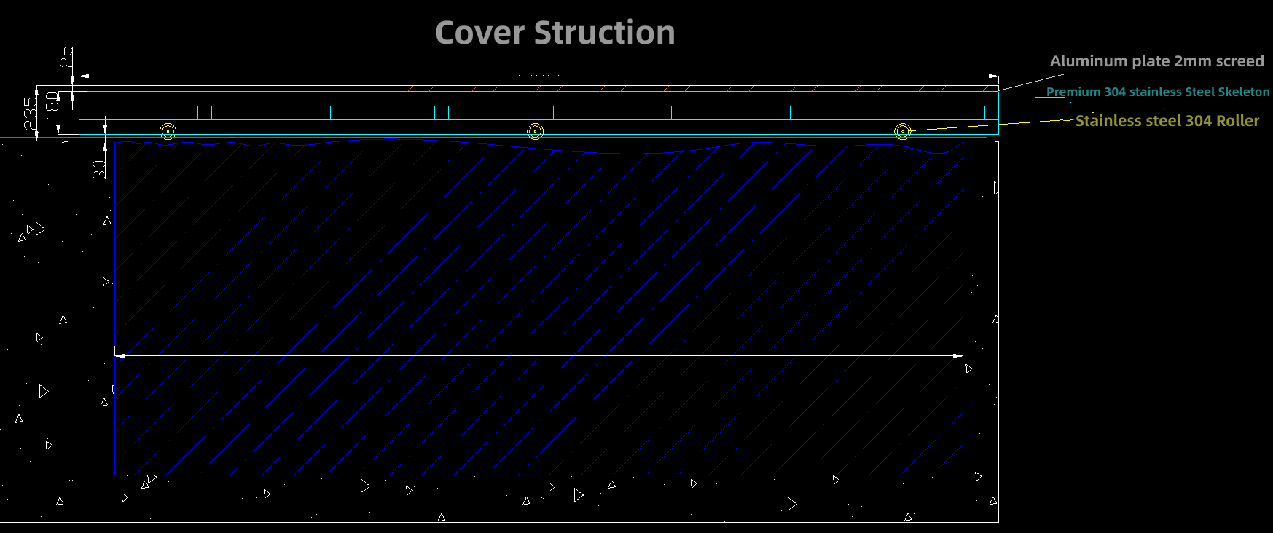
Contruction Diagram（2）

Slide 7
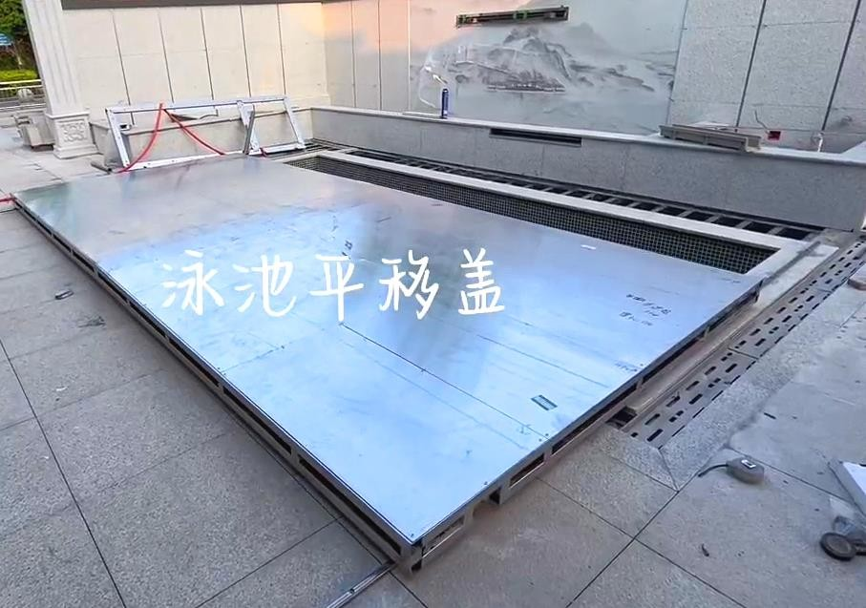
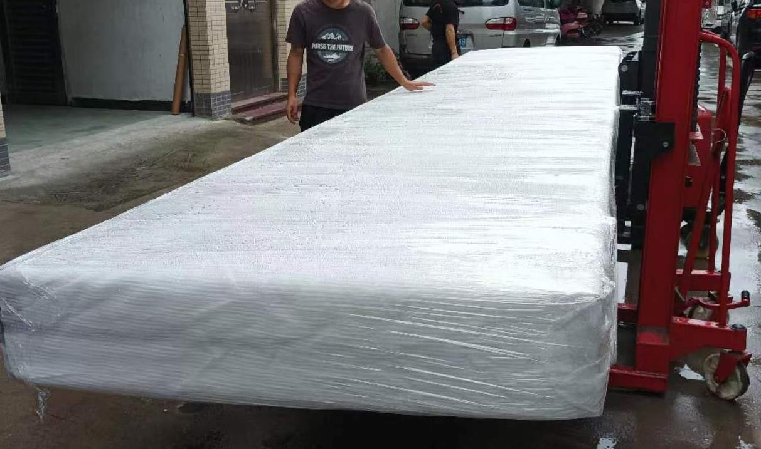
Details Of Product（2）
3 Frame: 304 double stainless steel keel structure
4、Motor: DC reduction motor
5、Control：Remote+Key Switch，Hall sensor
Electronic travel, automatic stop.
Finished product easy to installation

Slide 8
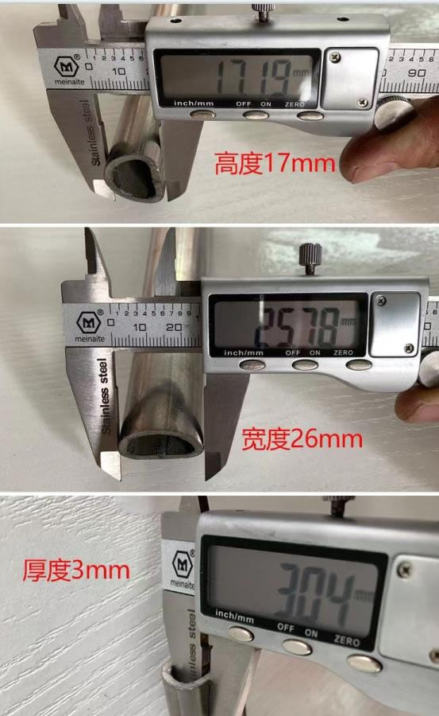
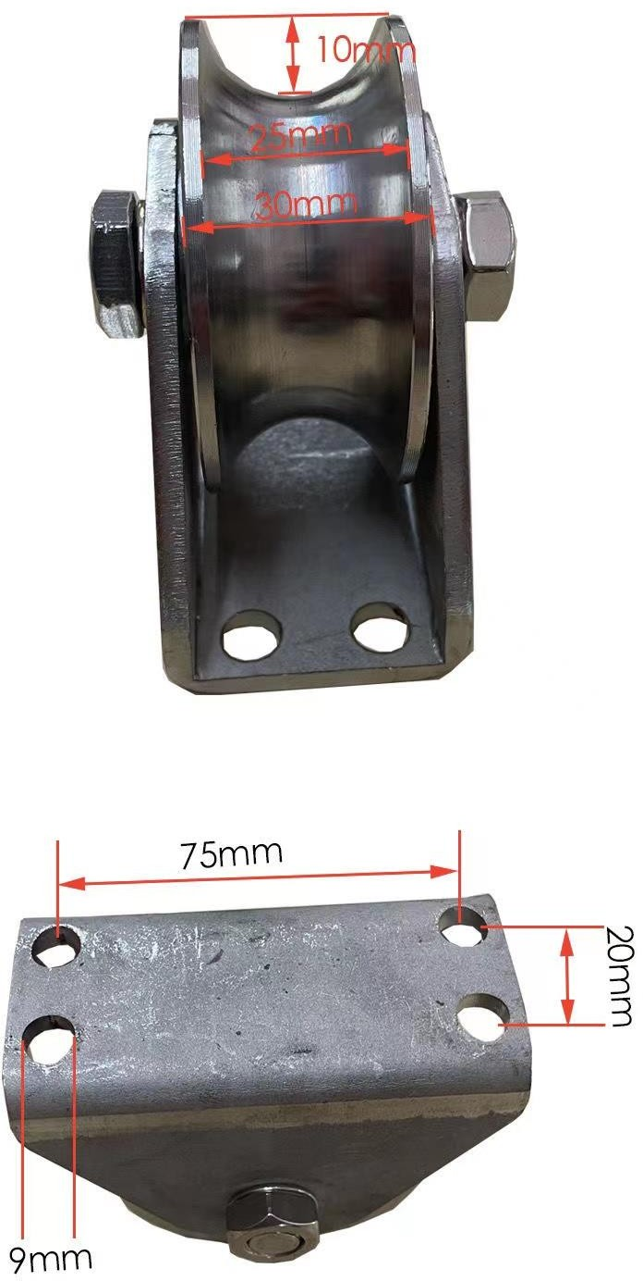
Details
1、304 stainless steel guide
Semi-arc design, can be installed directly fixed on the pool wall,On the
floor, can also be hidden, easy to clean the
guide groove.
2、304 stainless steel Solid wheel
Strong and durable, good bearing capacity

Slide 9
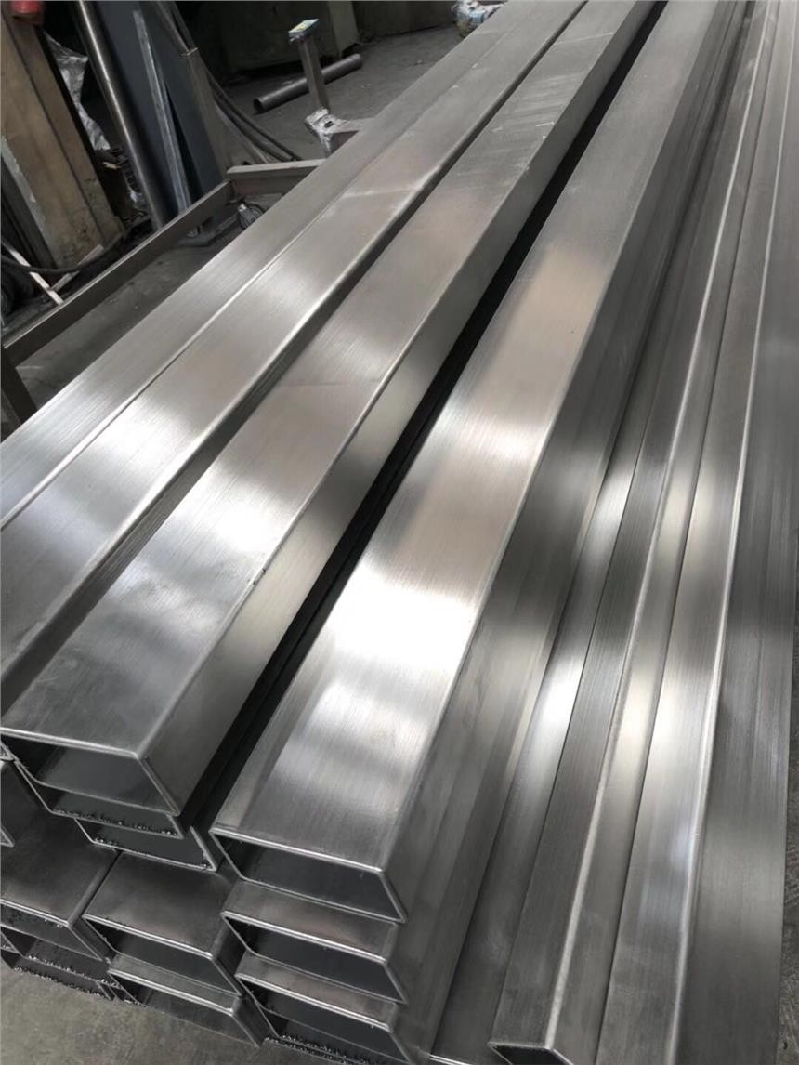
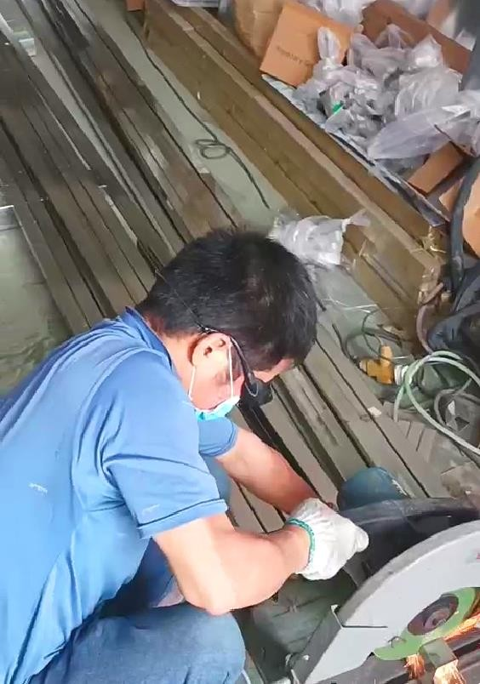
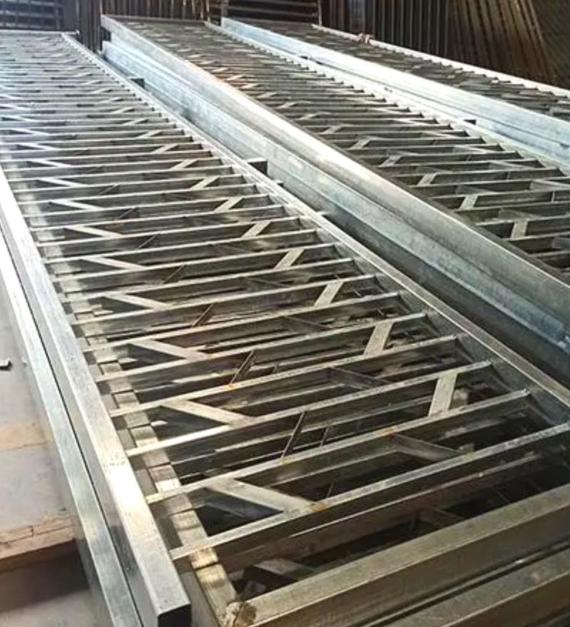
Workshop

Slide 10
七、Contact us
Thanks！

